Slide 2











$$h_{j}$$
$$C_{j−1}$$
x
+
$$C_{j}$$
x
$$σ$$
$$σ$$
$$tanh$$
$$tanh$$
$$h_{j−1}$$
$$σ$$
x
$$h_{j}$$
$$E_{j}$$

Slide 3






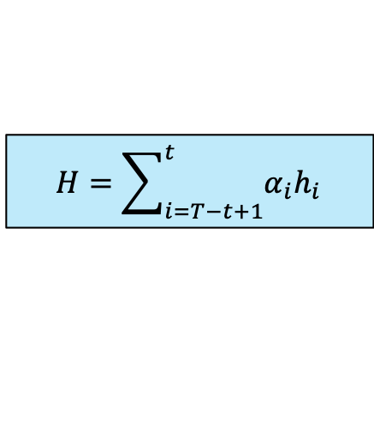


$$X_{t+1},…,X_{t+H}$$
Feed forward Layer
$$H=\sum_{i=T−t+1}^{t}{α_{i}h_{i}}$$
$α_{i}:$Temporal Attention Weights
$$h_{T−t+1}$$
…
$$h_{t}$$
LSTM Cell
…
LSTM Cell
$$E_{T−t+1}$$
…
$$E_{t}$$
$$X_{T−t+1}$$
…
$$X_{t}$$

Slide 4










$${\hat{X}}_{t+1},…,{\hat{X}}_{t+H}$$
Feedforward Layer
$$h_{T−t+1}$$
$$h_{j}$$
$$h_{t}$$
LSTM Cell
…
LSTM Cell
…
LSTM Cell
$$E_{T−t+1}$$
$$E_{j}$$
$$E_{t}$$
$$X_{T−t+1}$$
$$X_{j}$$
$$X_{t}$$

Slide 5
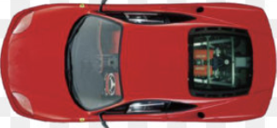
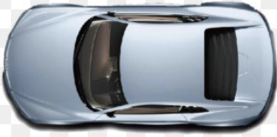

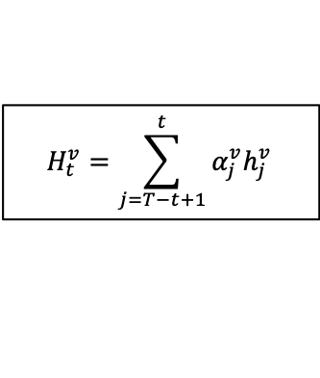



















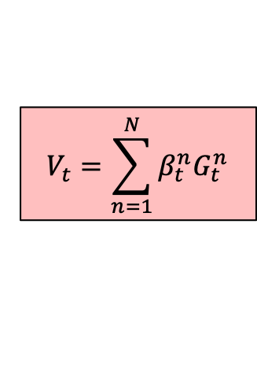




$${\hat{X}}_{t+1}^{ego},…, {\hat{X}}_{t+H}^{ego}$$
Calculate Temporal-level Attention Weights
$$A_{t}^{v}=[α_{T−t+1}^{v}, …,α_{j}^{v},…,α_{t}^{v}]$$
$$H_{t}^{v}=\sum_{j=T−t+1}^{t}{α_{j}^{v}h_{j}^{v}}$$
Ego Vehicle
Feedforward Layer
Neighbor Vehicles
$$V_{t}=\sum_{n=1}^{N}{β_{t}^{n}G_{t}^{n}}$$
$$h_{T−t+1}^{v}$$
$$h_{t}^{v}$$
Calculate Vehicle-level Attention Weights
$B_{t}=[β_{t}^{1},…,β_{t}^{n},…,β_{t}^{N}]$
LSTM Cell
…
LSTM Cell
$$H_{t}^{v}$$
$$E_{T−t+1}^{v}$$
$$E_{t}^{v}$$
0
$$15 feet$$
$$X_{T−t+1}^{v}$$
$$X_{t}^{v}$$
Left
Current
Right
$$−6$$
$$−5$$
$$−4$$
$$−3$$
$$−2$$
$$−1$$
$$0$$
$$1$$
$$2$$
$$3$$
$$4$$
$$5$$
$$6$$

Slide 6

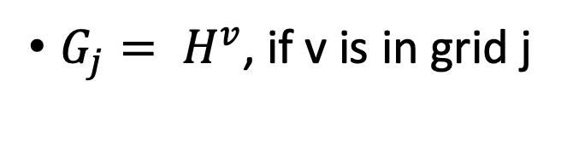
$G_{j}= H^{v}$, if v is in grid j
$G_{j}=0$, if no vehicle exists in grid j

Slide 7


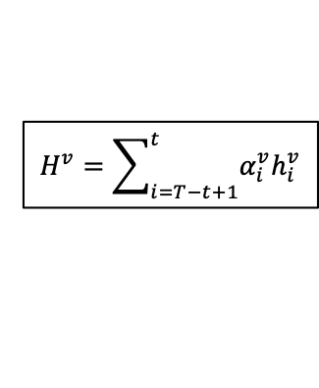




$$H^{v}=\sum_{i=T−t+1}^{t}{α_{i}^{v}h_{i}^{v}}$$
$$h_{T−t+1}^{v}$$
$$h_{t}^{v}$$
LSTM Cell
…
LSTM Cell
$$E_{T−t+1}^{v}$$
$$E_{t}^{v}$$
$$X_{T−t+1}^{v}$$
$$X_{t}^{v}$$

Slide 8
Ego Vehicle
Neighbor Vehicles
Weighted Summation of Hidden States
LSTM
Model
LSTM
Model
LSTM
Model
LSTM
Model
LSTM
Model
LSTM
Model
LSTM
Model

